Slide 1
Sentimental Analysis on Amazon Reviews
Team Members:
SHIVAKRISHNA VDDAGIRI (700739910)
JAGADEESH NALLIBOINA (700742755)
PUJA VAISHYA (700741750)

Slide 2
Table of contents
Roles and responsibilities
Motivation
Objectives
Related work
Problem Statement
Proposed Solution
Results
References

Slide 3
Roles and Responsibilities
JAGADEESH NALLIBOINA : Collected data sets and applied pre-processing techniques on the dataset.
PUJA VAISHYA : Tested and train the dataset using different parameter available.
SHIVAKRISHNA VDDAGIRI: Applied different machine learning algorithms and visualization techniques and also validated accuracy report of different algorithms.

Slide 4
Motivation
Today, information from social media is widely used by people, corporations, institutions, and governments to guide their actions (Liu, 2012).
A person no longer just asks those in his immediate vicinity when he wants to buy anything; instead, he searches online for reviews, discussions, and other information about the product.
An organization can also use the Internet to evaluate the quality of its goods and services. In a similar vein, it is simple for governments to learn about significant occurrences in other nations as well as to receive public opinion on their policies.
The work of finding, monitoring, and collecting information from opinion websites online is still challenging due to the proliferation of different websites. The typical human reader will struggle.

Slide 5
Objectives
The objective of sentiment analysis is to accurately extract people's opinions from a large number of unstructured review texts and classifying them into sentiment classes, i.e., positive, negative, or neutral. Sometimes “highly positive” and “highly negative” are also considered.
Sentiment analysis is also called opinion mining, which refers to the use of natural language processing and text mining to identify the emotional information from text materials.
Sometimes, social media behavior analysis also plays an important role in sentiment analysis and recommendation systems. Through social media, users can read online news, comment, like and share posts, blogs, and videos, and write reviews or opinions about products.

Slide 6
Related Work
Data Preprocessing: It is a process where we perform cleaning and modifying such as filling. missing values, removing irrelevant data, stop words etc. Which was collected from various resources .Different preprocessing techniques are applied with respective to data available.
Prediction: Each and every model is said to be good until and unless it have high prediction so the main aim of this project is to build the model which have high accuracy compare to baseline model.

Slide 7
Problem Statement
Here, We are going to retrieve reviews from the dataset and perform sentimental analysis.
Before performing sentimental analysis, we are going to clean unnecessary things such as hash tags, special symbols etc.
Finally, we take the clean review and perform sentimental analysis .

Slide 8
Proposed Solution
We are performing analysis using different machine learning algorithms to ensure that the particular model should have high accuracy compare to baseline model.
To Increase the accuracy we have used many different Python libraries such as NLTK, Seaborn etc.

Slide 9
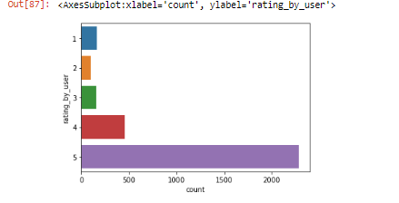
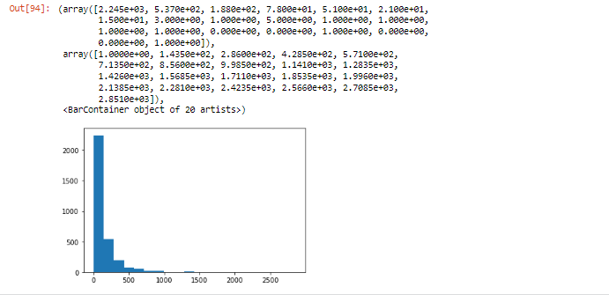
Results

Slide 10
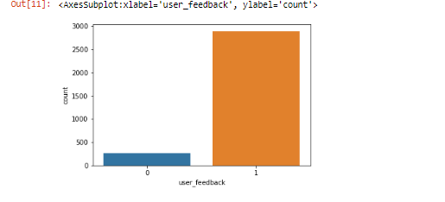
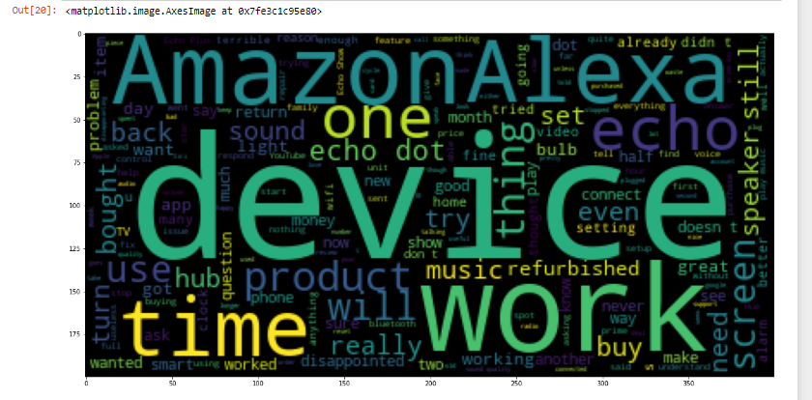
Results

Slide 11
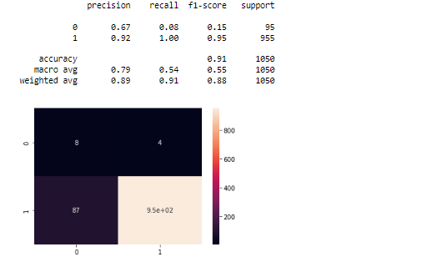
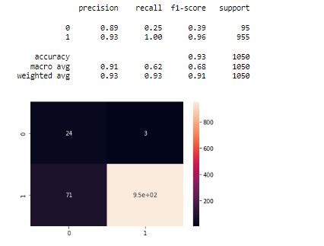
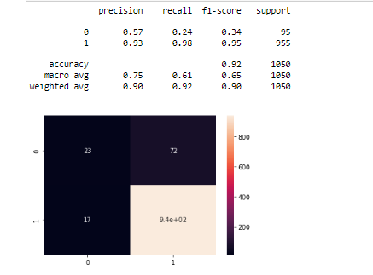
Results

Slide 12
References
1. Boothroyd, A., 2018. The benefits (and limitations) of online sentiment analysis tools [WWW Document]. Typely Blog. URL https://typely.com/blog/making-use-ofsentiment-analysis/ (accessed 5.17.19).
2. Brownlee, J., 2017. A Gentle Introduction to the Bag-of-Words Model [WWW Document]. URL https://machinelearningmastery.com/gentle-introduction-bagwords-model/ (accessed 5.15.19).
3. Chawla, N.V., Bowyer, K.W., Hall, L.O., Kegelmeyer, W.P., 2002. SMOTE: Synthetic Minority Over-sampling Technique. J. Artif. Intell. Res. 16, 321–357. https://doi.org/10.1613/jair.953
4. Determined22, 2017. Machine learning -- class imbalance problem and SMOTE oversampling algorithm [WWW Document]. URL https://www.cnblogs.com/Determined22/p/5772538.html (accessed 5.15.19). 5. Fang, X., Zhan, J., 2015. Sentiment analysis using product review data. J. Big Data 2,
5. https://doi.org/10.1186/s40537-015-0015-2 Grefenstette, G., Tapanainen, P., 1994. What is a word, Problems? 6. Liddy, E.D., 2000. Text Mining. Bull. Am. Soc. Inf. Sci. Technol. 27, 13–14. https://doi.org/10.1002/bult.184 Liu, B., 2012. Sentiment Analysis and Opinion Mining. Liu J., 2017a. The segmentation principle of text mining.

Slide 13
Thank you..

